Slide 1
ITMD 536 Software Testing & Maintenance
Chapter 13, 14, 15 & 16 Major Update,
When to Retire the System,
Future Shock, An Action Plan & Winning the Battles for Prestige, Resources & Recognition

Slide 2
Objectives
What is real options concepts?
What is feasibility study?
What is concept benefits trade-offs?
What are cost-effectiveness analysis?
What are other techniques?
What are death spirals?
What are retirement plans?

Slide 3
Objectives
What are development options?
What is cutover?
What are you looking into the future?
What are the development technologies?
What are the technology readiness levels?

Slide 4
Objectives
What is lean manufacturing (KANBAN)?
How can users be maintainers?
What is could computing and its impact?
How can you play to win?
How can you develop your support base?

Slide 5
Objectives
How can you win the battle of the budget?
How can you keep the users involved?
How can you deliver exceptional products and services?
How can you be successful?

Slide 6
What is Enhancement?
Refers to added capabilities to an existing capability in a manner that preserves the previous functionality and performance.

Slide 7
What is Retirement?
Permanent removal of support or of the product from operations.
Retirement phase is the period of time in the software life cycle during which support for a software product is terminated.

Slide 8
13 Being Ready for the Next Major Upgrade
13.1 Real Option Concepts
Justification for change must first make technical sense within the context of the upgrade. They must also have a champion. Someone needs to stand up and say that the change being proposed is important. The timeliness for change also need to be compatible.

Slide 9
13 Being Ready for the Next Major Upgrade
Your request will not be approved if it slows down things like a major upgrade.
Most important, the change must generate benefits that justify the costs.
Real options analysis permits alternatives in such a case to be

Slide 10
13 Being Ready for the Next Major Upgrade
Evaluated taking risk into account using the following six-step approach:
Step 1. Assessment: You would conduct a basic financial analysis in terms of the cost and benefits associated with the software being considered as a COSTS replacement.
Uncertainties would be identified

Slide 11
13 Being Ready for the Next Major Upgrade
Along with their likely impacts relative to user satisfaction, which is considered the main factor that governs selection among the alternatives.
Step 2. Risk Determination: you would investigate the risks and quantify the uncertainties associated

Slide 12
13 Being Ready for the Next Major Upgrade
With requirements and performs capabilities and capacities in monetary terms.
Step 3. Options Analysis: as your next step, you would identify real options that address the risks associated with the software investments being considered.

Slide 13
13 Being Ready for the Next Major Upgrade
You can consider option to paying the COTS vendor to add features or of course there are yet other options that might be pursued, like providing needed features via plug-in modules or confirming that the user is all right with abandoning the requirements.

Slide 14
13 Being Ready for the Next Major Upgrade
Step 4 – Options Valuation: The next step is to value the options using the information you have at your disposal. You can do this simply by computing costs. Take the ranges of uncertainty and this will help bound the risk involved with the options.

Slide 15
13 Being Ready for the Next Major Upgrade
Step 5 – Investment Valuation: It sounds like a lot of work to come up with a valuation of options. You take the numbers, compare them, and make a decision.
Step 6 – Execution: The last step assumes that the decision makers are smart enough to execute the real

Slide 16
13 Being Ready for the Next Major Upgrade
Options when it is in their best interests to do so. The real options provide them with an advantage because they provide the means to address risk in their decisions. Uncertainties associated with software purchasing decisions sometimes lead to unnecessary risks

Slide 17
13 Being Ready for the Next Major Upgrade
That often can be prevented.
You now have a strategy, support, paperwork, and justification in hand to push ahead with changes that you are going to recommend be made along with the next major upgrade.

Slide 18
13 Being Ready for the Next Major Upgrade
13.2 Feasibility Studies
The traditional thing that you would do when addressing a major upgrade is perform a feasibility study. Such a study is done ultimately to develop a plan of action and milestones for performing the major upgrade with minimum disruption and at

Slide 19
13 Being Ready for the Next Major Upgrade
Minimum cost during the scheduled time period.
The following feasibility study plan outline – report needs to be completed but you may omit that do not apply.
Feasibility study plan outline:

Slide 20
13 Being Ready for the Next Major Upgrade
1. Executive summary
2. Background and needs assessment
2.1 System/software overview
2.2 Upgrade overview
2.3 Needs assessment
2.4 Statutory requirements
3. Organizational impacts

Slide 21
13 Being Ready for the Next Major Upgrade
3.1 Organizational involved
3.2 Operational environment
3.3 Maintenance environment
3.4 Points of contact
4. Proposed solution
4.1 Specific work products
4.2 Major features/functions to be added
4.3 Repairs to be made

Slide 22
13 Being Ready for the Next Major Upgrade
4.4 New business processes that need to be supported
4.5 Facility and equipment upgrades
5. Major options considered
6. Conformity with information technology (IT) portfolio
6.1 Strategic impact on business or IT goals

Slide 23
13 Being Ready for the Next Major Upgrade
6.2 Technology impacts
7. Project management impacts
7.1 Roles and responsibilities
7.2 Project team organization and leadership
8. Sustaining engineering impacts
8.1 User support
8.2 Field service support

Slide 24
13 Being Ready for the Next Major Upgrade
9. Facility impacts
10. Operational impacts
10.1 Dual/parallel operations plans
10.2 Information security plans
11. Estimated timeline and work plan
12. Cost-benefit analysis

Slide 25
13 Being Ready for the Next Major Upgrade
You should make a compelling technical and business case for the change.
Timing is strategy. Make sure your results are available in time to influence the decision and get funded.

Slide 26
13 Being Ready for the Next Major Upgrade
Cost-Benefit Trade-Offs
Nonrecurring costs: Tangible Benefits
License fees, Cost avoidance
Tailoring Cost, Avoid development cost
Integration cost, Tailoring part of

Slide 27
13 Being Ready for the Next Major Upgrade
Cost-Benefit Trade-Offs
Recurring costs (5yrs): Tangible Benefits
License fees, Immediate availability
Maintenance, fewer bugs
Training fee, Someone else handles updates

Slide 28
13 Being Ready for the Next Major Upgrade
Anticipate that a major system/software upgrade will occur every five/seven years
Piggy-back other work that needs to be updated as it’s needed
Readiness in most important not just resources but the budget
Change is inevitable – be ready for it

Slide 29
14 Knowing When to Retire the System
Death Spirals – know when to retire the system
Retirement Plans:
High cost and maintenance issues
Poor quality
Capabilities of the system are no longer needed
High cost for upgrades
Technology not supported

Slide 30
14 Knowing When to Retire the System
Development options
Architecture needs
Data migration needs
Knowledge needs
Legacy reengineering needs
Process reengineering needs
Readiness needs

Slide 31
14 Knowing When to Retire the System
Cutover
Personnel
Equipment
Architecture
Processes
Facilities
Databases
Knowledge
Infrastructure
Legacy

Slide 32
15 Future Shock – An Action Plan
Looking to the Future
Agile methods
Cloud computing
Grid computing
Intelligent databases
Lean manufacturing (Kanban)
Predictive analysis
Semantic Web
Service-oriented architecture

Slide 33
15 Future Shock – An Action Plan
Looking to the Future
Software as a service
Storage virtualization
Utility computing (pay-as-you-go)
Users as programmers

Slide 34
15 Future Shock – An Action Plan
Technology Readiness Level (TRL)
Basic principles observed and reported
Technology concept or application formulated
Analytical experimental proof of concept
Validation in laboratory environment
Validation in relevant environment

Slide 35
15 Future Shock – An Action Plan
Technology Readiness Level (TRL)
Prototype demonstration in a relevant environment
System prototype demonstration in a operational environment
Actual system completed using technology and tested in its operational environment
Actual system that uses technology taken through successful operations

Slide 36
15 Future Shock – An Action Plan
Lean Manufacturing (KANBAN)
Overproduction
Transportation
Waiting
Motion
Defects
Processing
Inventory

Slide 37
16 Winning the Battles for Prestige, Resources, and Recognition
“Life’s battles don’t always go the stronger or faster man. But sooner or later the man who wins, is the one that thinks he can.” Vince Lombardi
Planning to Win
Developing Your Support Base
Winning the Battle of the Budget

Slide 38
16 Winning the Battles for Prestige, Resources, and Recognition
“Keeping the Users Involved
Delivering Exceptional Products and Services
You can be Successful
Do what is needed and nothing else
Focus on the things that really matter
Recognize that your resources are limited

Slide 39
16 Winning the Battles for Prestige, Resources, and Recognition
Get everyone involved, but not too involved
Focus changes on both product-and processes related improvement
Do the essential things first to maintain your credibility
Be satisfied with a 90 percent solution

Slide 40
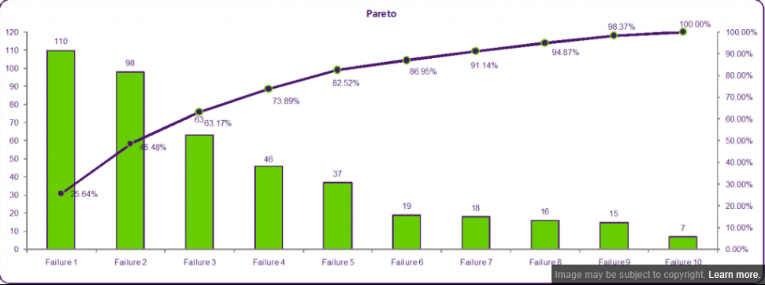

Slide 41
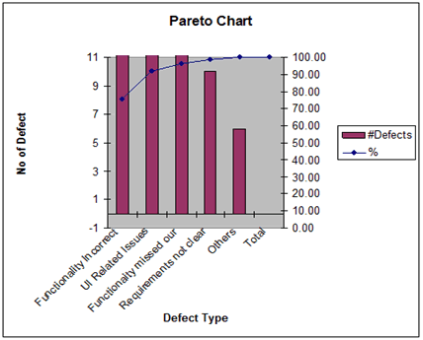

Slide 42
Final Exam Group Project
Final Exam
Group Project Presentation
December 1st and 8th
10:00 to 12:40 PM

